Slide 1

ENTITY-RELATIONSHIP MODEL
2.E-R Model
Unit -II

Slide 2
Topics to be covered
Design Process
Modeling: Entity, attributes, relationship.
Constraints: keys, Cardinality, participation.
Weak entities.
E-R Diagram Generalization Specialization and aggregation.
Conceptual design with ER Model.
Entity versus Attribute, Entity versus Relationship, Binary Versus Ternary relationship.
Aggregate versus Ternary relationship and
Case studies on Design of the Bank Database.
2.E-R Model

Slide 3
Entity-Relationship Model
1976 proposed by Peter Chen
ER diagram is widely used in database design
  Represent conceptual level of a database system
  Describe things and their relationships in high level
2.E-R Model

Slide 4
Entity-Relationship Model
This model allows us to describe the data involved in a real world enterprise in terms of objects and their relationships.
It is widely used to develop an initial database design.
It is a one of several semantic data models.
It is very useful in mapping the meanings and interactions of real–world enterprise onto a conceptual schema.
2.E-R Model

Slide 5
Design Process
It can be divided into 6 steps ,first 3 steps are relevant to E-R Model.
Requirement analysis.
Conceptual database design.
Logical database design.
Schema refinement.
Physical database design.
Application security design
2.E-R Model

Slide 6
Design Process Steps
Requirement analysis.
What data to be stored?
what application must be used ?
What the users want from data base?
Conceptual database design.
The information gathered in the requirement analysis is used to develop a high-level description of the data to be stored in the database.
E-R model is one of several high-level data model used in database design.
2.E-R Model

Slide 7
Data base Design Process
Logical database design.
We must choose DBMS to implement our database design & convert the conceptual database design into database schema.
Eg: E-R model into RDBMS
2.E-R Model

Slide 8
Data base Design Process
Schema refinement:
  It is to analyze the collection of relations in our relational database schema to identify potential problems and to refine it .
eg: Normalization.
2.E-R Model

Slide 9
Data base Design Process
Physical database design:
we must consider typical expected workloads that our database must support and further refine database design to ensure that it meets desired performance criteria.
Eg: building indexes
Application security design:
We must describe the role of each entity in every process that is reflected in application task, as a part of complete work flow for that task.
Eg: access control
2.E-R Model

Slide 10
2.Modeling
A database can be modeled as:
  a collection of entities,
  relationship among entities.
An entity is an object that exists and is distinguishable from other objects.
  Example: specific person, company, event, plant
Entities have set of Properties are called attributes.
  Example: people have names and addresses
An entity set is a set of entities of the same type that share the same properties.
  Example: set of all persons, companies, holidays
2.E-R Model

Slide 11
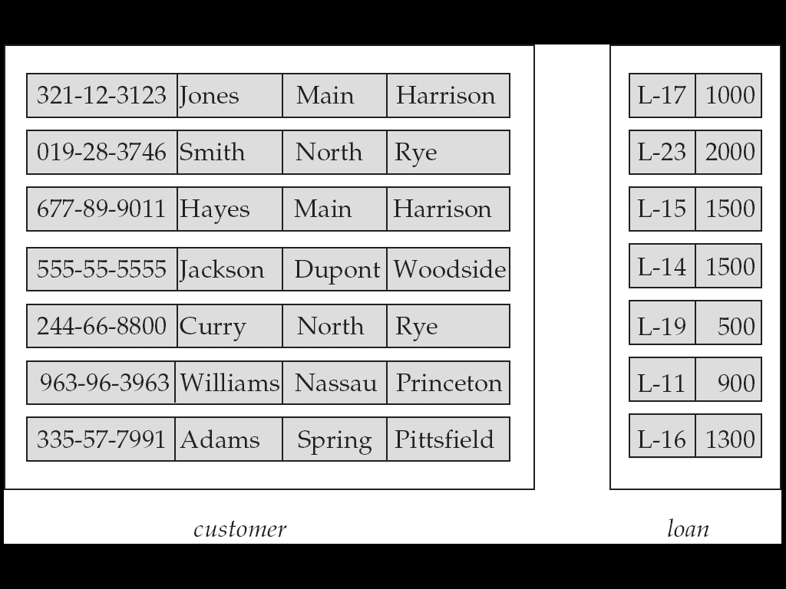
Entity Sets customer and loan
customer_id customer_ customer_ c ustomer_ loan_ amount
name street city number
2.E-R Model

Slide 12
Relationship Sets
A relationship is an association among several entities
Example:
Hayes depositor A-102
customer entity relationship set account entity
A relationship set is a mathematical relation among n ≥ 2 entities, each taken from entity sets
{(e₁, e₂, … e_{n}) | e₁ ∈ E₁, e₂ ∈ E₂, …, e_{n} ∈ E_{n}}
where (e₁, e₂, …, e_{n}) is a relationship
  Example:
  (Hayes, A-102) ∈ depositor
2.E-R Model

Slide 13
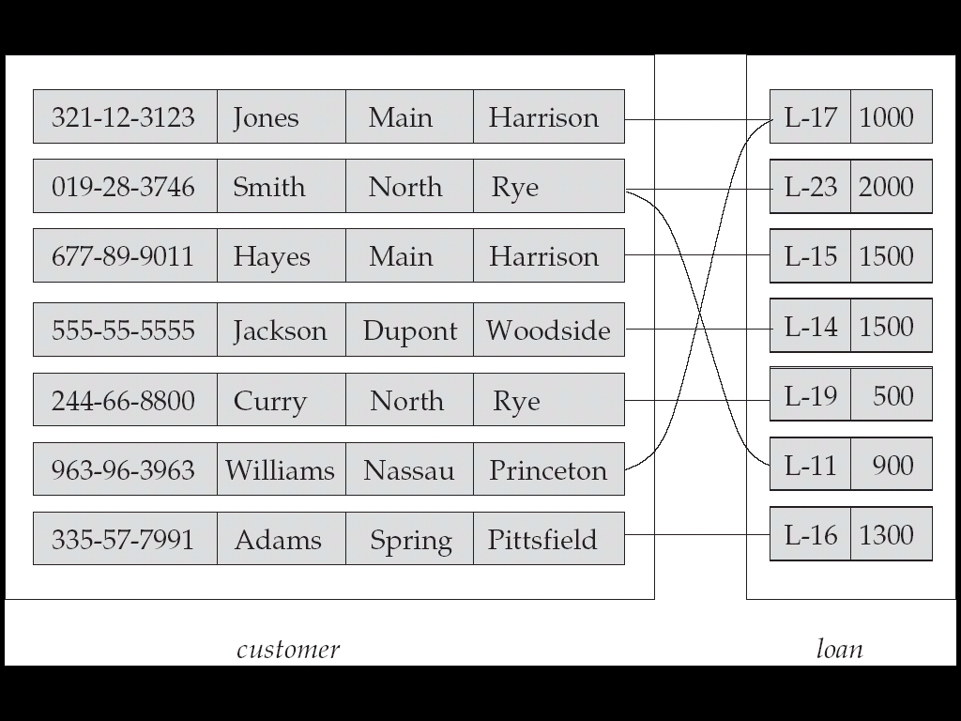
Relationship Set borrower
customer_id customer_ customer_ c ustomer_ loan_ amount
name street city number
2.E-R Model

Slide 14
Relationship Sets (Cont.)
An attribute can also be property of a relationship set.
Eg:
the depositor relationship set between entity sets customer and account may have the attribute access-date
2.E-R Model

Slide 15
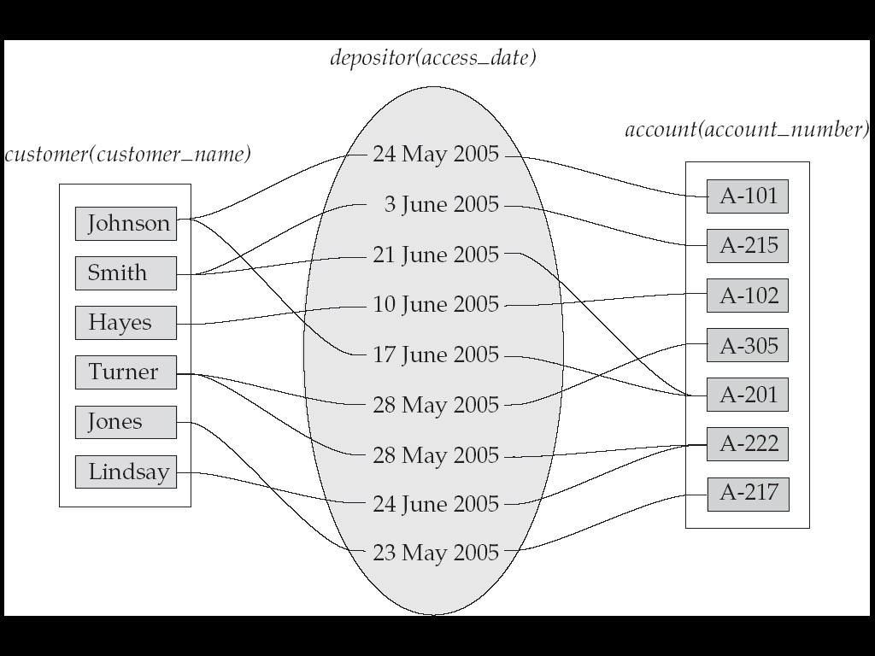
Relationship Sets (Cont.)
2.E-R Model

Slide 16
Degree of a Relationship Set
Refers to number of entity sets that participate in a relationship set.
Relationship sets that involve two entity sets are binary (or degree two).
Relationships between more than two entity sets are rare. Most relationships are binary
Relationship sets may involve more than two entity sets.
  Example: Suppose employees of a bank may have jobs (responsibilities) at multiple branches, with different jobs at different branches. Then there is a ternary relationship set between entity sets employee, job, and branch
2.E-R Model

Slide 17
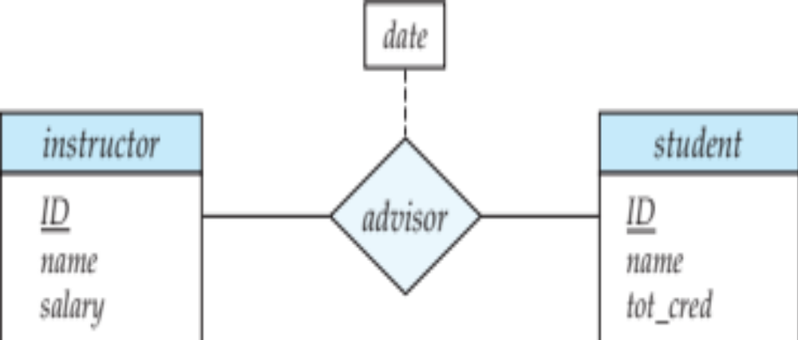
Relationship Sets with Attributes
2.E-R Model

Slide 18




Attributes
An entity is represented by a set of attributes, that is descriptive properties possessed by all members of an entity set.
Domain – the set of permitted values for each attribute
Attribute types:
  Simple and composite attributes.
  Single-valued and multi-valued attributes
    Example: multivalued attribute: phone_numbers
  Derived attributes
    Can be computed from other attributes
    Example: age, given date_of_birth experience
Example:
customer = (customer_id, customer_name, customer_street, customer_city )
loan = (loan_number, amount )
2.E-R Model

Slide 19
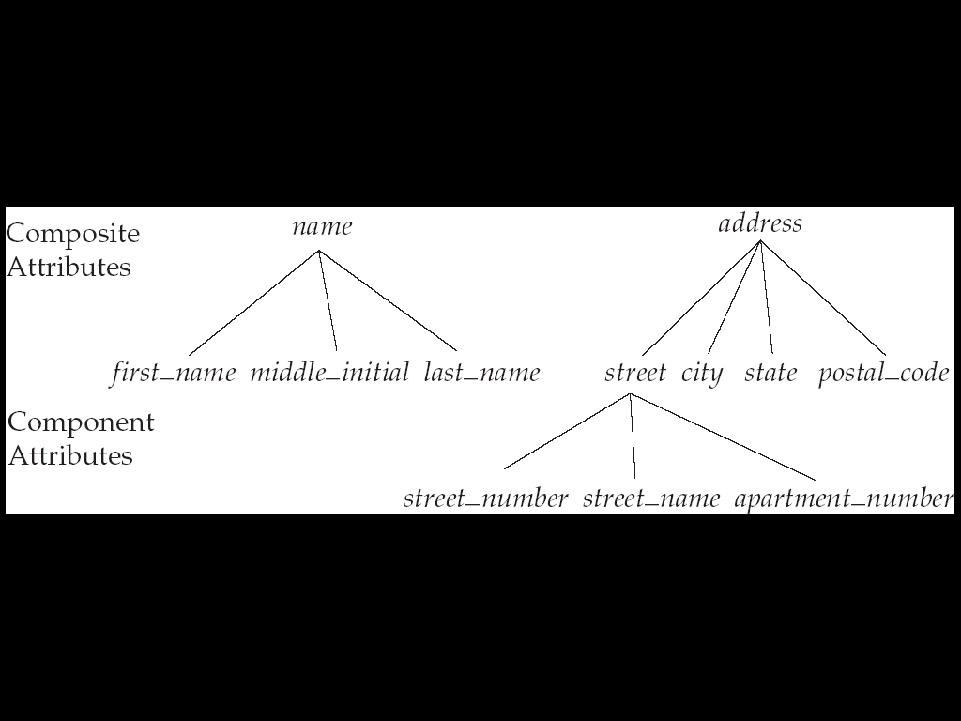
Composite Attributes
2.E-R Model

Slide 20
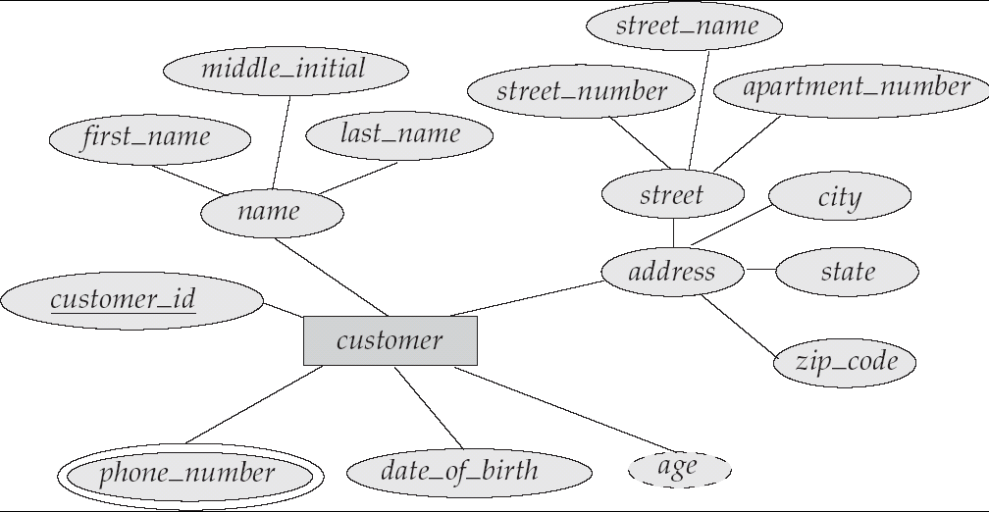




E-R Diagram With Composite, Multivalued, and Derived Attributes
2.E-R Model

Slide 21
3.Constraints: Cardinality, keys, participation.
2.E-R Model

Slide 22
Mapping Cardinality Constraints
Express the number of entities to which another entity can be associated via a relationship set.
Most useful in describing binary relationship sets.
For a binary relationship set the mapping cardinality must be one of the following types:
  One to one
  One to many
  Many to one
  Many to many
2.E-R Model

Slide 23
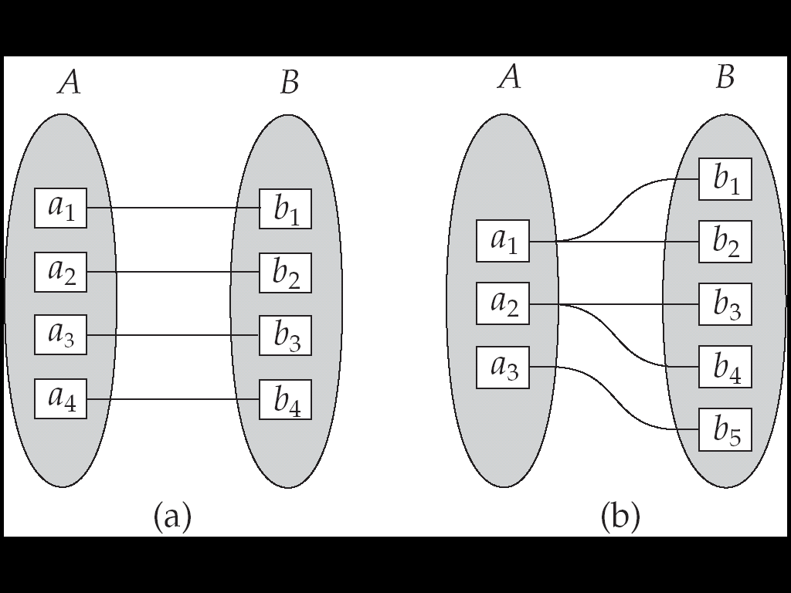
Mapping Cardinalities
One to one
One to many
Note: Some elements in A and B may not be mapped to any
elements in the other set
2.E-R Model

Slide 24
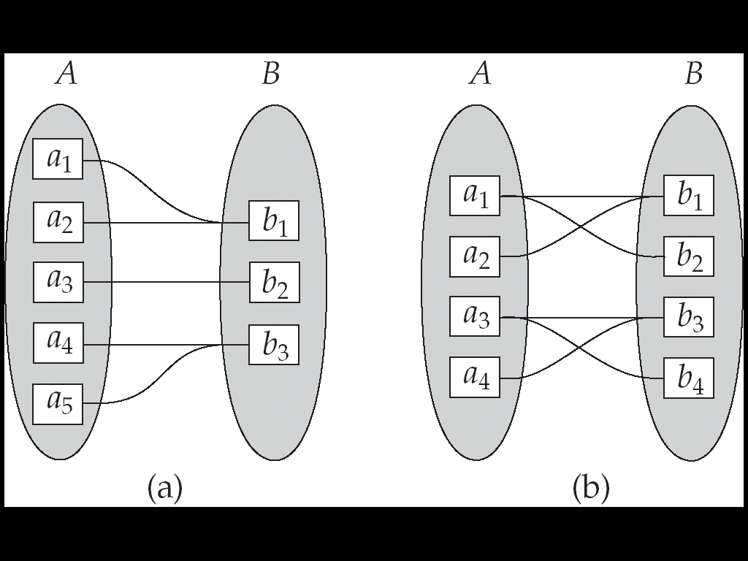
Mapping Cardinalities
Many to one
Many to many
Note: Some elements in A and B may not be mapped to any
elements in the other set
2.E-R Model

Slide 25
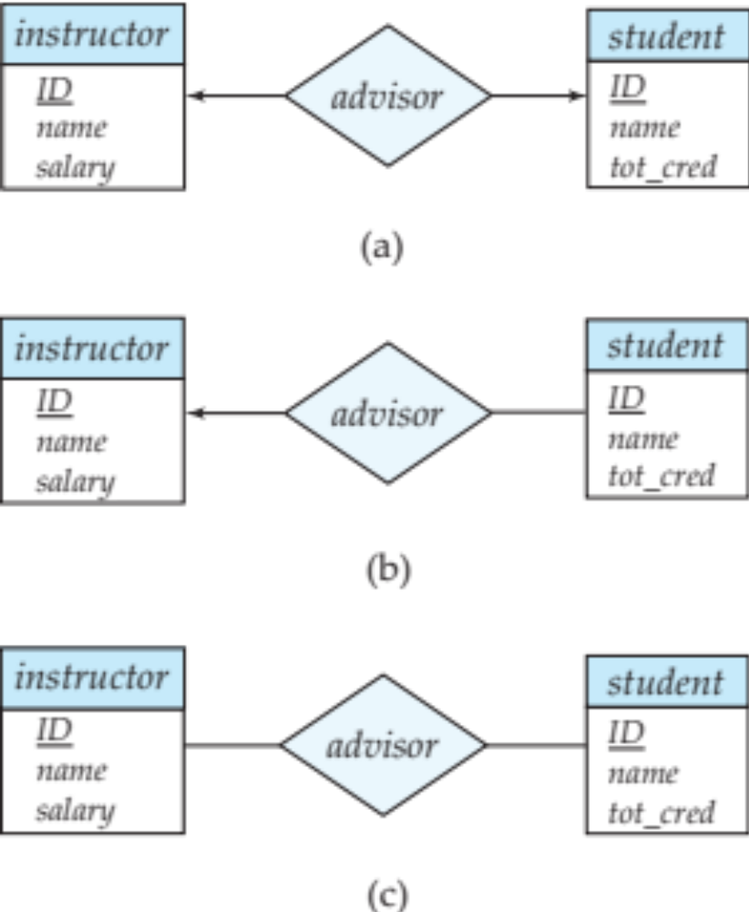
One-one
one-to-one relationship between an instructor and a student
  an instructor is associated with at most one student via advisor
  and a student is associated with at most one instructor via advisor
  Eg: employee
2.E-R Model

Slide 26
One- Many
one-to-many relationship between an instructor and a student
  an instructor is associated with several (including 0) students via advisor
  a student is associated with at most one instructor via advisor,
2.E-R Model

Slide 27
Many - One
In a many-to-one relationship between an instructor and a student,
  an instructor is associated with at most one student via advisor,
  and a student is associated with several (including 0) instructors via advisor
2.E-R Model

Slide 28
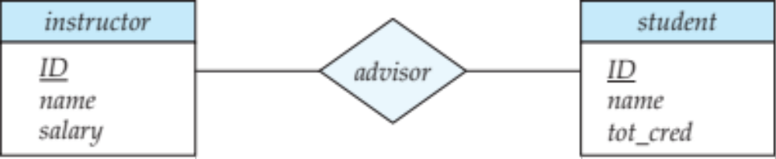
Many - Many
An instructor is associated with several (possibly 0) students via advisor
A student is associated with several (possibly 0) instructors via advisor
2.E-R Model

Slide 29
Note on Mapping Cardinality
Both many and 1 include 0
  Meaning some entity may not participate in the relationship.
The appropriate mapping cardinality for a particular relationship set depends on the real world situation that the relationship is modeling.
2.E-R Model

Slide 30
Entity Key, Candidate key and Super Key
Primary key: The Primary key of an entity is an attribute or a set of attributes that uniquely identifies a specific instance of an entity.
Every entity in the entity relationship model must have a primary key
Candidate key of an entity set is a minimal super key
  Customer_id is candidate key of customer
  account_number is candidate key of account
Although several candidate keys may exist, one of the candidate keys is selected to be the primary key.
2.E-R Model

Slide 31
Keys for Relationship Sets
The combination of primary keys of the participating entity sets forms a super key of a relationship set.
  (customer_id, account_number) is the super key of depositor
  NOTE: this means a pair of entity sets can have at most one relationship in a particular relationship set.
Must consider the mapping cardinality of the relationship set when deciding what are the candidate keys.
Need to consider semantics of relationship set in selecting the primary key in case of more than one candidate key.
2.E-R Model

Slide 32
Redundant Attributes
Suppose we have entity sets
  instructor, with attributes including dept_name
  Department and a relationship
  inst_dept relating instructor and department
Attribute dept_name in entity instructor is redundant since there is an explicit relationship inst_dept which relates instructors to departments
  The attribute replicates information present in the relationship, and should be removed from instructor
  BUT: when converting back to tables, in some cases the attribute gets reintroduced, as we will see.
2.E-R Model

Slide 33
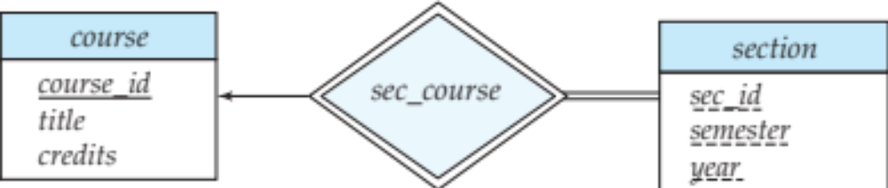
Participation Constraints
Total participation (indicated by double line): every entity in the entity set participates in at most one relationship in the relationship set
  E.g., participation of section in sec_course is total
    every section must have an associated course
2.E-R Model

Slide 34

Total Participation
When we require all entities to participate in the relationship (total participation), we use double lines to specify
Every loan has to have at least one customer
2.E-R Model

Slide 35
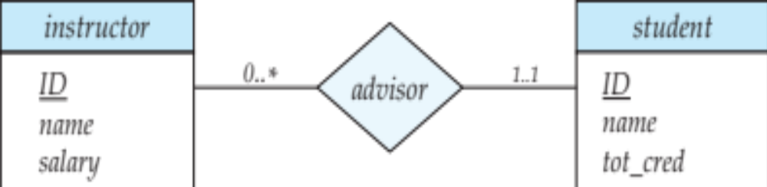
Partial Participation
Partial participation: some entities may not participate in any relationship in the relationship set
  Example: participation of instructor in advisor is partial
  Cardinality limits can also express participation constraints
2.E-R Model

Slide 36

Self Relationship
Sometimes entities in a entity set may relate to other entities in the same set, Thus self relationship.
Here employees mange some other employees.
The labels “manger” and “worker” are called roles the self relationship.
2.E-R Model

Slide 37
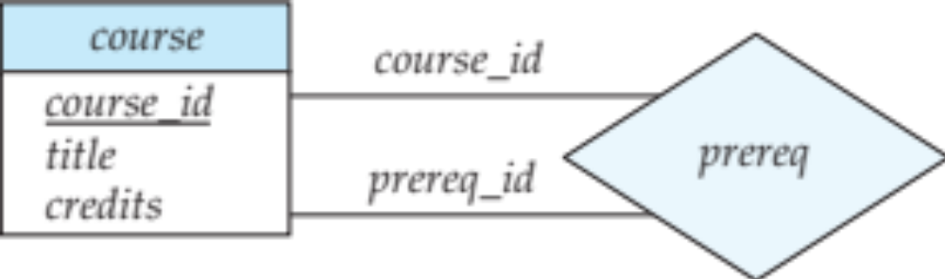
Roles
Entity sets of a relationship need not be distinct
  Each occurrence of an entity set plays a “role” in the relationship
The labels “course_id” and “prereq_id” are called roles.
Each occurrence of an entity set plays a “role” in the relationship.
2.E-R Model

Slide 38
More examples on self-relationship
People to people
  Parent – children
  Manager – employee
Word to word
  Root – synonym
2.E-R Model

Slide 39
4.Weak Entities
WEAK ENTITY SET: An entity set may not have sufficient attributes to form a primary key & is termed as a weak entity set.
STRONG ENTITY SET: An entity set that has a primary key is termed as a strong entity set.
2.E-R Model

Slide 40
Weak Entity Set
The existence of a weak entity set depends on the existence of a identifying entity set
  It must relate to the identifying entity set via a total, one-to-many relationship set from the identifying to the weak entity set
  Identifying relationship depicted using a double diamond.
The discriminator (or partial key) of a weak entity set is the set of attributes that distinguishes among all the entities of a weak entity set.
The primary key of a weak entity set is formed by the primary key of the strong entity set on which the weak entity set is existence dependent, plus the weak entity set’s discriminator.
2.E-R Model

Slide 41

WEAK ENTITY SET REPRESENTATION
A weak entity set is indicated in E-R Dig. By a doubly outlined box and the corresponding identifying relationship by a doubly outlined diamond.
2.E-R Model

Slide 42
Another example
Payment_num
--------------
amount
Loan_num
Loan_amount
loan
lending
payment
2.E-R Model

Slide 43
Weak Entity Set
We underline the discriminator of a weak entity set with a dashed line.
We put the identifying relationship of a weak entity in a double diamond.
Primary key for section – (course_id, sec_id, semester, year)
2.E-R Model

Slide 44
Characteristics
A weak entity set may participate as owner in an identifying relationship with another weak entity set.
A weak entity set must have total participation in Identifying relationship set.
A weak entity set and its owner entity set must participate in many to one relationship set.
2.E-R Model

Slide 45
Extended E-R Features:Specialization
Top-down design process: we designate subgroupings within an entity set that are distinctive from other entities in the set.
These subgroupings become lower-level entity sets that have attributes or participate in relationships that do not apply to the higher-level entity set.
Depicted by a triangle component labeled ISA (E.g. customer “is a” person).
Attribute inheritance – a lower-level entity set inherits all the attributes and relationship participation of the higher-level entity set to which it is linked.
2.E-R Model

Slide 46
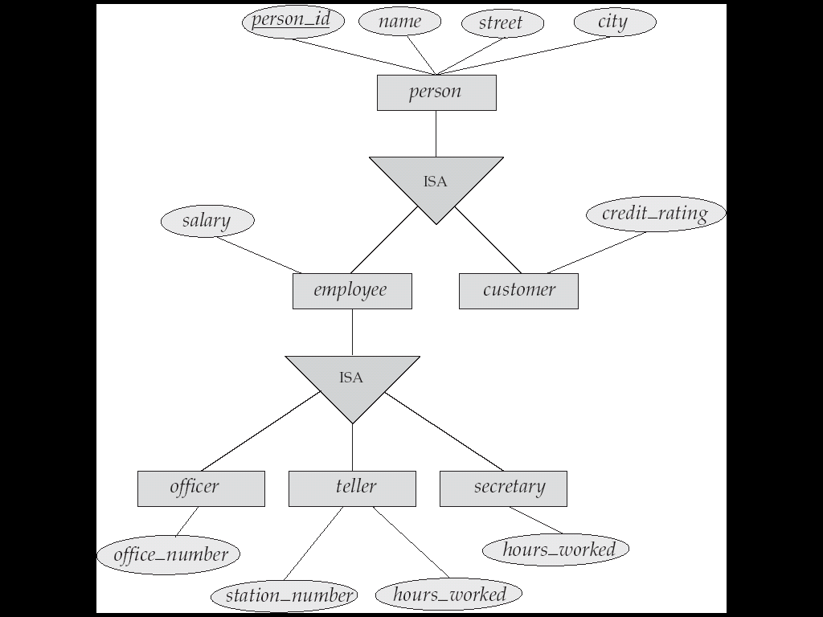
Specialization Example
2.E-R Model

Slide 47
Extended ER Features:Generalization
A bottom-up design process :– combine a number of entity sets that share the same features into a higher-level entity set.
Specialization and generalization are simple inversions of each other; they are represented in an E-R diagram in the same way.
The terms specialization and generalization are used interchangeably.
2.E-R Model

Slide 48
Specialization and Generalization (Cont.)
We Can have multiple specializations of an entity set based on different features.
E.g. permanent_employee vs. temporary_employee, in addition to officer vs. secretary vs. teller
Each particular employee would be
  a member of one of permanent_employee or temporary_employee,
  and also a member of one of officer, secretary, or teller
The ISA relationship also referred to as superclass - subclass relationship.
2.E-R Model

Slide 49
Design Constraints on a Specialization/Generalization
Constraint on which entities can be members of a given lower-level entity set.
  Condition-defined
    Example: all customers over 65 years are members of senior-citizen entity set; senior-citizen ISA person.
  User-defined
2.E-R Model

Slide 50
Design Constraints on a Specialization/Generalization
Constraint on whether or not entities may belong to more than one lower-level entity set within a single generalization.
  Disjoint
    an entity can belong to only one lower-level entity set
    Noted in E-R diagram by writing disjoint next to the ISA triangle
  Overlapping
    an entity can belong to more than one lower-level entity set
2.E-R Model

Slide 51
Design Constraints on a Specialization/Generalization (Cont.)
Completeness constraint -- specifies whether or not an entity in the higher-level entity set must belong to at least one of the lower-level entity sets within a generalization.
  Total : an entity must belong to one of the lower-level entity sets.
  Partial : an entity need not belong to one of the lower-level entity sets.
2.E-R Model

Slide 52
Aggregation
Consider the ternary relationship works_on, which we saw earlier
Suppose we want to record managers for tasks performed by an
employee at a branch
For example, to represent aggregation manages between relationship works_on and entity set manager, create a schema
manages (employee_id, branch_name, title, manager_name)
Schema works_on is redundant provided we are willing to store null values for attribute manager_name in relation on schema manages
2.E-R Model

Slide 53
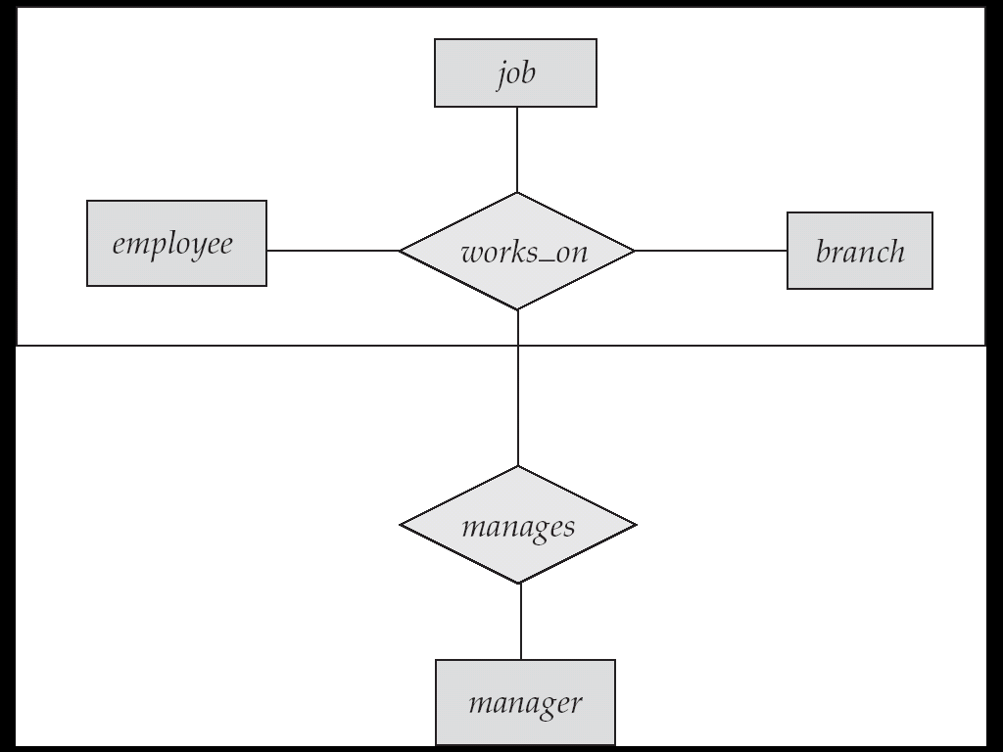
E-R Diagram With Aggregation
2.E-R Model

Slide 54
ssn
name
lot
Example FOR AGGREGATION
Employees
Monitors
since
Started_on
dname
did
pbudget
budget
Pid
Projects
Sponsors
Departments
2.E-R Model

Slide 55
Aggregation (Cont.)
Relationship sets works_on and manages represent overlapping information
  Every manages relationship corresponds to a works_on relationship
  However, some works_on relationships may not correspond to any manages relationships
    So we can’t discard the works_on relationship
Eliminate this redundancy via aggregation
  Treat relationship as an abstract entity
  Allows relationships between relationships
  Abstraction of relationship into new entity
Without introducing redundancy, the following diagram represents:
  An employee works on a particular job at a particular branch
  An employee, branch, job combination may have an associated manager
2.E-R Model

Slide 56
E-R Diagram represents
Rectangles represent entity sets.
Diamonds represent relationship sets.
Lines link attributes to entity sets and entity sets to relationship sets.
Ellipses represent attributes
  Double ellipses represent multivalve attributes.
  Dashed ellipses denote derived attributes.
Underline indicates primary key attributes (will study later)
2.E-R Model/D.S.Jagli
2.E-R Model

Slide 57
E-R Design Decisions
The use of an attribute or entity set to represent an object.
Whether a real-world concept is best expressed by an entity set or a relationship set.
The use of a ternary relationship versus a pair of binary relationships.
The use of a strong or weak entity set.
The use of specialization/generalization – contributes to modularity in the design.
The use of aggregation – can treat the aggregate entity set as a single unit without concern for the details of its internal structure.
2.E-R Model

Slide 58
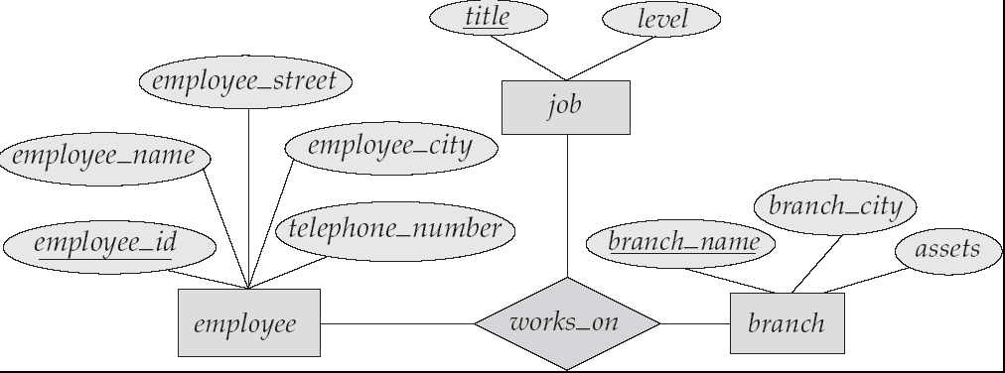
E-R Diagram with a Ternary Relationship
2.E-R Model/D.S.Jagli
2.E-R Model

Slide 59
Design Issues
Use of entity sets vs. attributes
Choice mainly depends on the structure of the enterprise being modeled, and on the semantics associated with the attribute in question.
Use of entity sets vs. relationship sets
Possible guideline is to designate a relationship set to describe an action that occurs between entities.
Binary versus n-ary relationship sets
Although it is possible to replace any nonbinary that several entities participate in a single relationship.
Placement of relationship attributes
2.E-R Model/D.S.Jagli
2.E-R Model

Slide 60
Binary Vs. Non-Binary Relationships
Some relationships that appear to be non-binary may be better represented using binary relationships
  But there are some relationships that are naturally non-binary
    Example: works_on
2.E-R Model/D.S.Jagli
2.E-R Model

Slide 61

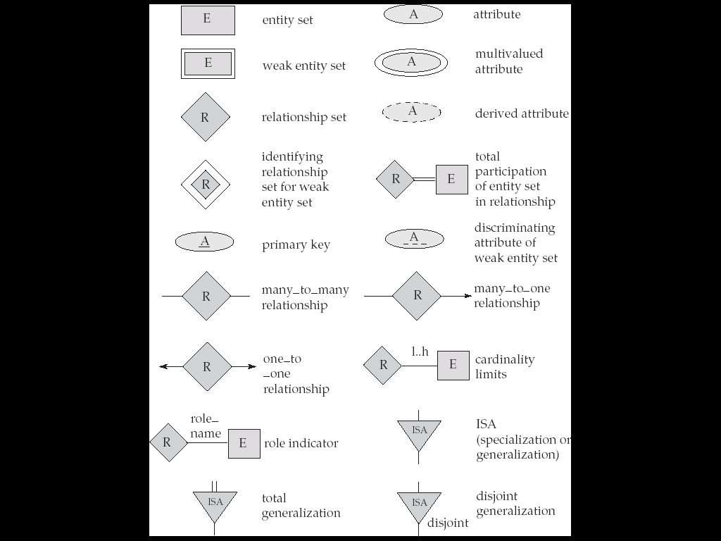
Summary of Symbols Used in E-R Notation
2.E-R Model

Slide 62

Summary of Symbols (Cont.)
2.E-R Model

Slide 63
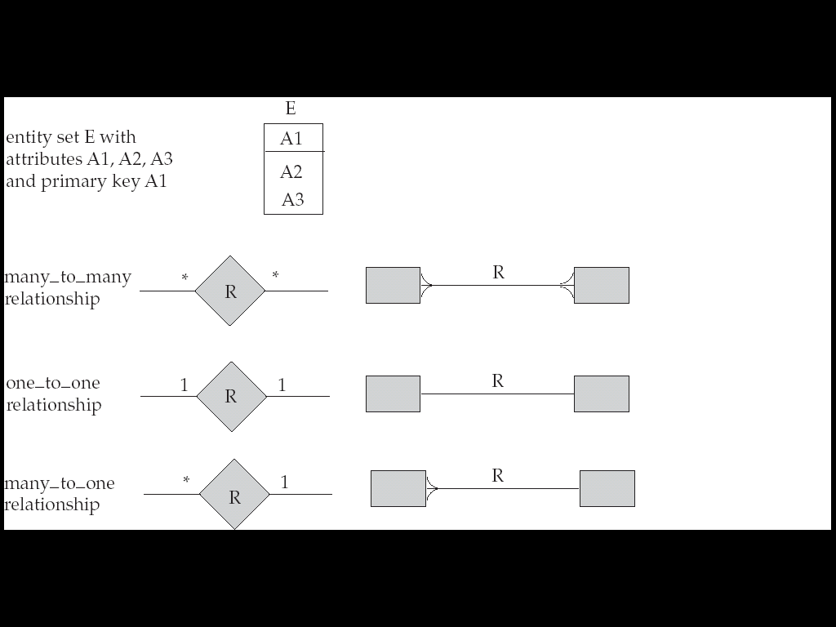
Alternative E-R Notations
2.E-R Model

Slide 64
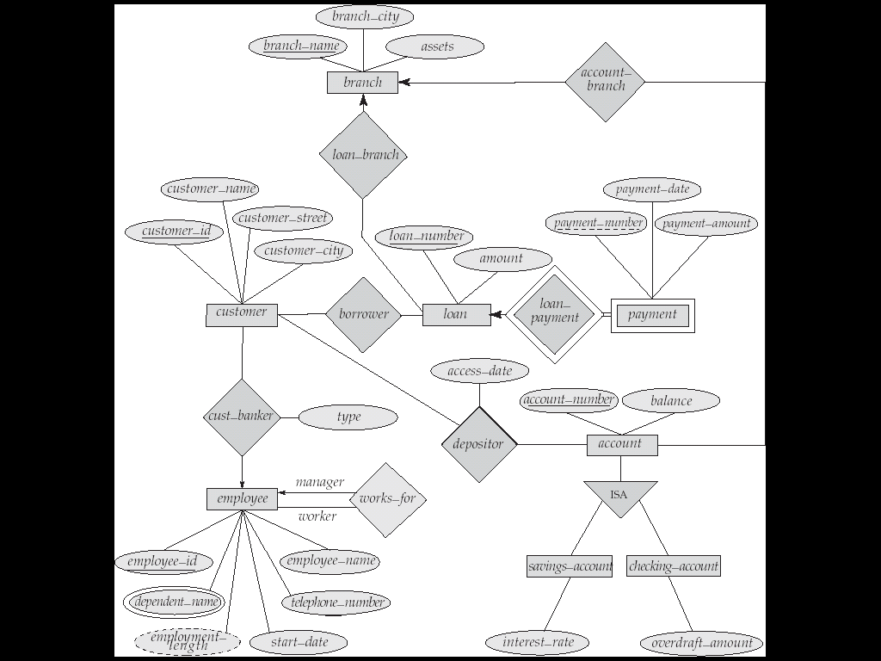
E-R Diagram for a Banking Enterprise
2.E-R Model

Slide 65
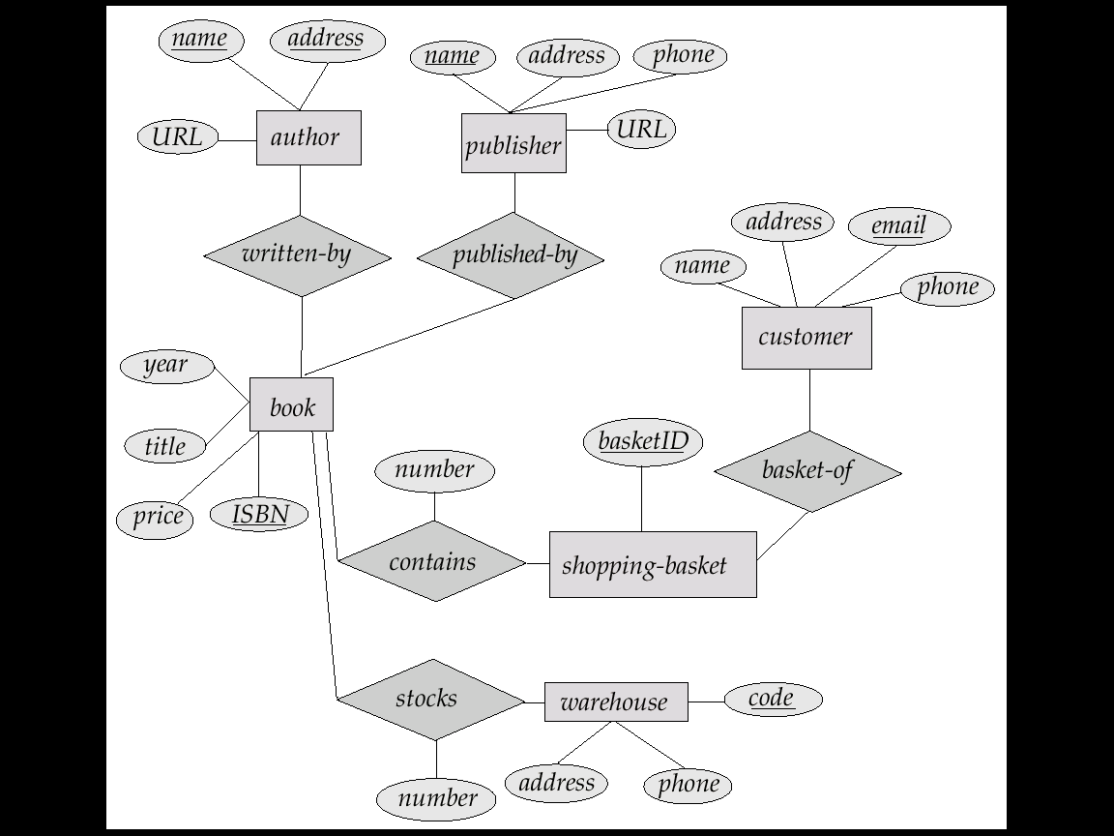
E-R Diagram for Book Store
2.E-R Model

Slide 66
Thank you
? ? ?
2.E-R Model

